Slide 1
Invisibility Cloak Challenge Week
GRPa11
Brandon Eastwell
Alexander Duncombe-Jones
Andreas Ellinas
Woyenginanaye Edward Etete

Slide 2
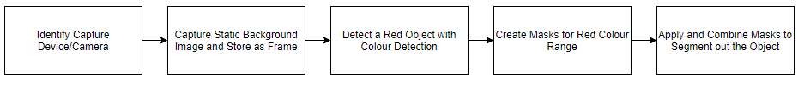
Planning
Initially our group had begun by assigning each other essential roles that would take part in different areas of development for the project, however we quickly discovered it would be more beneficial and efficient for our team to contribute to all steps in sequence due to inconsistencies in our team structure.
As a team, we agreed to use tools such as github to manage our teams' files allowing us to share contributions and resources to each other on the team.
Research > Develop

Slide 3
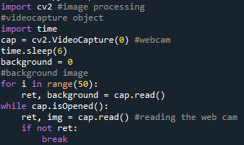
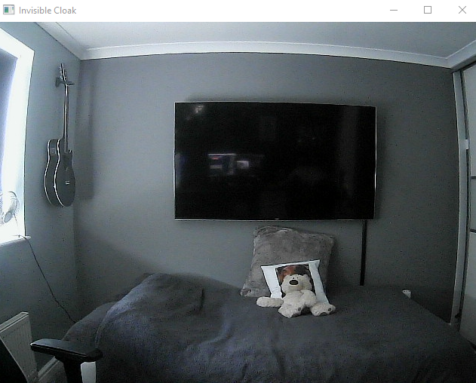
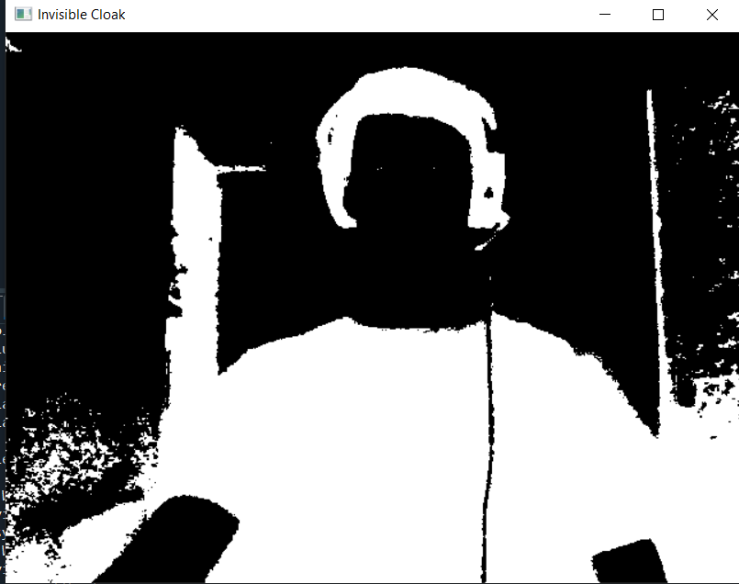
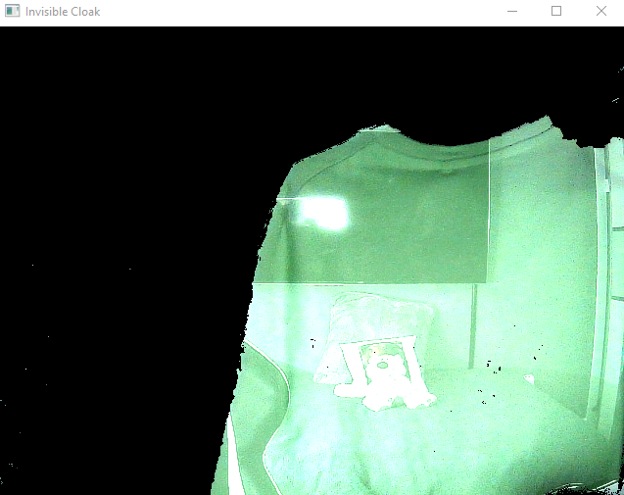
Development Process
In order to learn and understand the necessary skills, we used Google and other sources of information such as Youtube to explore various implementations of the Invisible Cloak.
We black box tested our program throughout the development of subsystems such as the camera functionality and how both the masks worked on the background image as well as the object being detected before combination.

Slide 4


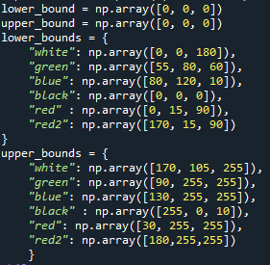
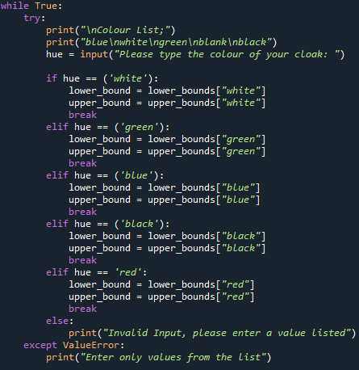
Further Improvements
Instead of a singular red color, we gave the user different options of color with validation for user friendliness.
Increased the amount of time the user has before the camera device takes a still image.

Slide 5
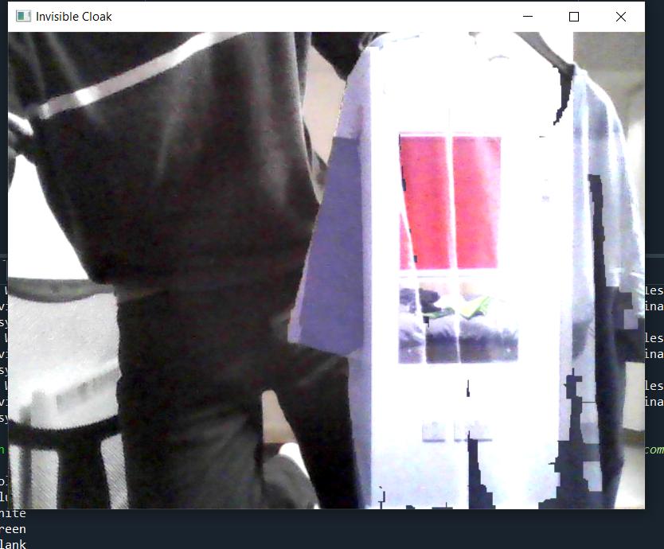
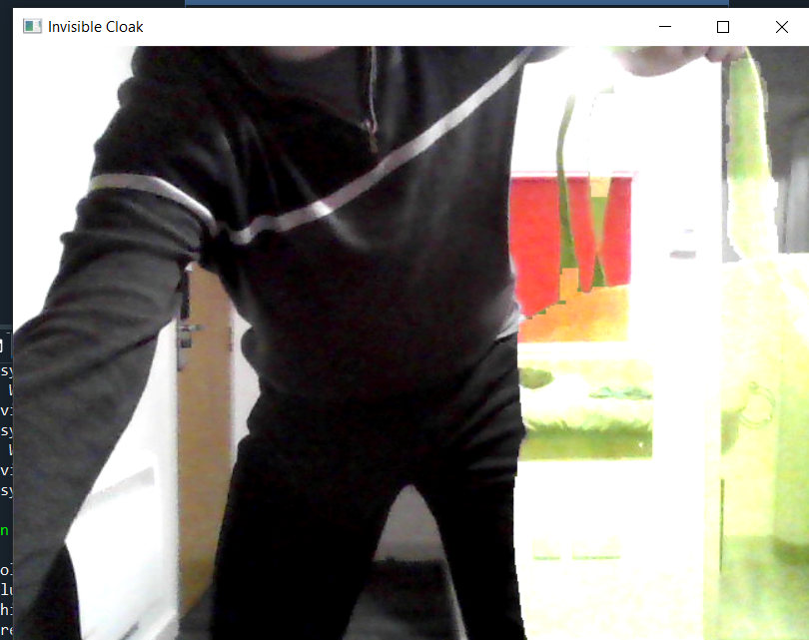
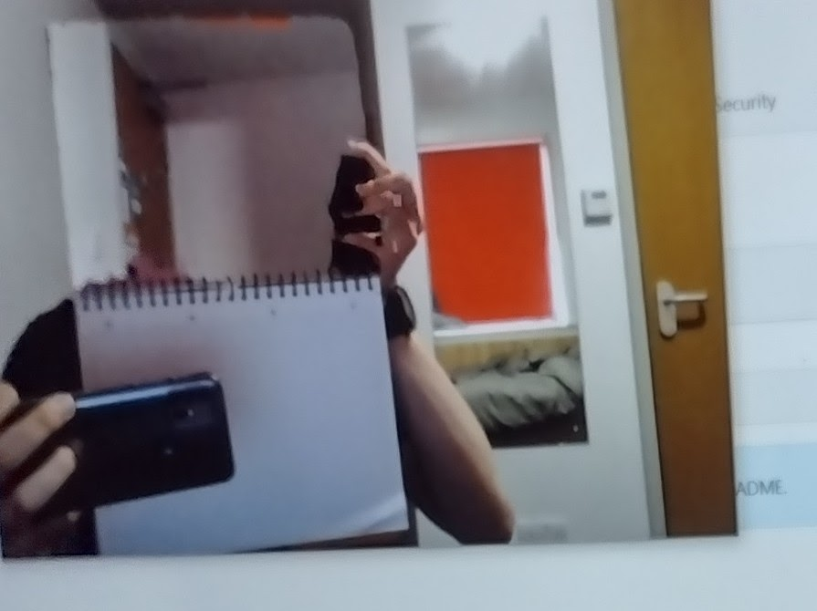
Evidence
BLUE
GREEN
RED

Slide 6
Solution 1 Vs Solution 2

Slide 7
Conclusion
In conclusion, our final solution produced the best results we had experienced achieving the magic cloak affect desired.
If we had more time and experience..
Automatic Cloak Detection
Dynamic Background, additional cameras

